Slide 1
Lecture 2
Linear Regression as Machine Learning Algorithm

Slide 2
Introduction
In a previous lesson you learned the principle of linear regression
In this lecture we are going to revisit linear regression in the light of machine learning
Notes:
In a previous lesson you learned the principle of linear regression
In this lecture we are going to revisit linear regression in the light of machine learning
In fact linear regression is a typical example of supervised machine learning

Slide 3










Machine learning terminology
Linear regression is used in machine learning when a linear relationship between input data and output data can be assumed
The input data does usually contain more than a single entry
For example the input could be the pixel values of a picture
$$\underline{x}=\left[\begin{matrix}x_{1} \\ \begin{aligned}x_{2} \\ x_{3} \\ ⋮\end{aligned} \\ x_{n}\end{matrix}\right]$$
$$x_{1}$$
$$x_{2}$$
$$x_{3}$$
$$x_{4}$$
$$x_{5}$$
$$x_{6}$$
$$⋯$$
$$⋯$$
$$x_{n}$$
Notes:
Linear regression is used in machine learning when a linear relationship between input data and output data can be assumed
Note that the input data does usually contain more than a single entry
A typical example is the case of an image as input. In this case each pixel value of the image is part of the input data
One numbers the pixel x1, x2 etc.. until the last one xn
The input of this image is then the vector x=[x1, x2,x3,….xn]
The complete data set is made up out of a collection of images.
So the input data set will be a collection of vectors x each of them having n entries

Slide 4
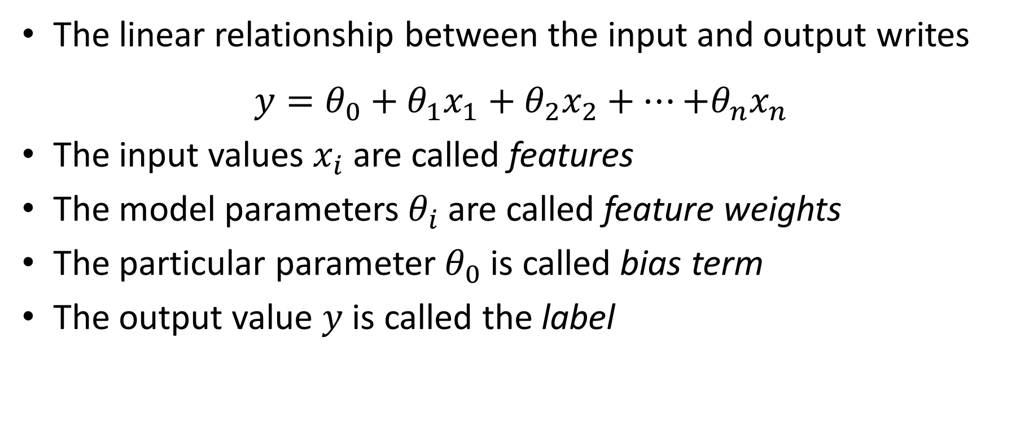
Machine learning terminology
The linear relationship between the input and output writes
$$y=θ_{0}+{θ_{1}x}_{1}+{θ_{2}x}_{2}+…{+θ_{n}x}_{n}$$
The input values $x_{i}$ are called features
The model parameters$θ_{i}$ are called feature weights
The particular parameter $θ_{0}$ is called bias term
The output value $y$ is called the label
Notes:
The linear relationship between the input and output writes
$$y=θ_{0}+{θ_{1}x}_{1}+{θ_{2}x}_{2}+…{+θ_{n}x}_{n}$$
In the case of an image representing a numerical digit, the values x1 to xn are the pixel values of the image and the output y could be the numerical value of the digit represented by the image
In the context of machine learning the input values $x_{i}$ are called features
The model parameters$θ_{i}$ are called feature weights
The particular parameter $θ_{0}$ is called bias term
And the output value $y$ is called the label

Slide 5
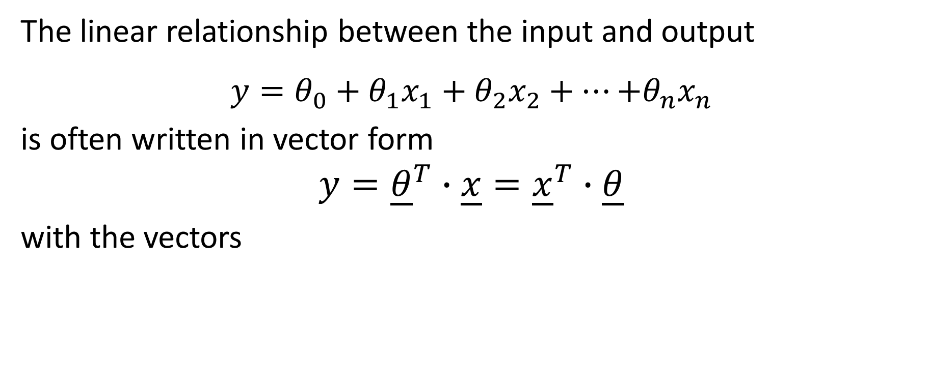


Vector notation
The linear relationship between the input and output
$$y=θ_{0}+{θ_{1}x}_{1}+{θ_{2}x}_{2}+…{+θ_{n}x}_{n}$$
is often written in vector form
$$y={\underline{θ}}^{T}∙\underline{x}={\underline{x}}^{T}∙\underline{θ}$$
with the vectors
$$\underline{θ}=\left[\begin{matrix}θ_{0} \\ \begin{aligned}θ_{1} \\ θ_{2} \\ ⋮\end{aligned} \\ θ_{n}\end{matrix}\right]$$
$$\underline{x}=\left[\begin{matrix}1 \\ \begin{aligned}x_{1} \\ x_{2} \\ ⋮\end{aligned} \\ x_{n}\end{matrix}\right]$$
Notes:
It is very common to use a vector notation to represent this linear relationship
For this one writes $y={\underline{θ}}^{T}∙\underline{x}={\underline{x}}^{T}∙\underline{θ}$
Where one has introduced two vectors $\underline{θ}$ and $\underline{x}$
The first one is the column vector [$θ_{0}$, $θ_{1}$, $θ_{2}$, etc until $θ_{n}$]
It is termed the feature weight vector
The second one is the column vector $\underline{x}$ [1, $x_{1}$, $x_{2}$, etc until $x_{n}$]
Note the number 1 in the first entry
To add this ‘1’ is a mathematical trick commonly used in machine learning to allow to write the linear model in the form $y={\underline{θ}}^{T}∙\underline{x}$. This way the bias term is kind of hidden and doesn’t make troubles in calculations
This trick can however as well be source of confusions, especially when using existing libraries of machine learning algorithms. It is very important to always read carefully the documentation of the library to know if this trick was included or not.
The same holds when reading textbooks or other sources on theoretical developments
In this lesson, unless we mention it explicitly, we always use this trick and add the ‘1’

Slide 6







Data set
Machine learning will handle data sets
For example a collection of pictures
Each entry ${\underline{x}}^{(i)}$ in the data set is called an instance or an example
$$⋯$$
$${\underline{x}}^{(1)}$$
$${\underline{x}}^{(2)}$$
$${\underline{x}}^{(3)}$$
$$⋯$$
$${\underline{x}}^{(m)}$$
Notes:
In machine learning we handle data sets
Such sets are for example made out of a collection of pictures
We use a superscript in brackets to number them ${\underline{x}}^{(1)}$, ${\underline{x}}^{(2)}$ etc until ${\underline{x}}^{(m)}$
Note that we have n features and m entries in the data set. It is important to not mix up the number of features and the number of entries in the data set
In our example, the features are the pixel of a image and they are numbered from 1 to n
The entries in the data set are the pictures and they are numbered from 1 to m
Each entry ${\underline{x}}^{(i)}$ in the data set is called an instance or an example

Slide 7












Data set
In supervised learning (the only case we will discuss) each instance ${\underline{x}}^{(i)}$ in the data set will have a corresponding label $y^{(i)}$ associated to it
$$⋯$$
$${\underline{x}}^{(1)}$$
$${\underline{x}}^{(2)}$$
$${\underline{x}}^{(3)}$$
$$⋯$$
$${\underline{x}}^{(m)}$$
$$y^{(1)}$$
$$y^{(2)}$$
$$y^{(3)}$$
$$⋯$$
$$y^{(m)}$$
Notes:
In this semester we consider only supervised learning
In this case, each instance ${\underline{x}}^{(i)}$ in the data set will have a corresponding label $y^{(i)}$ associated to it
In case of pictures of digits that label could be the numerical value of the digit inside the picture
As for the instances we use a superscript in brackets to number the lables

Slide 8
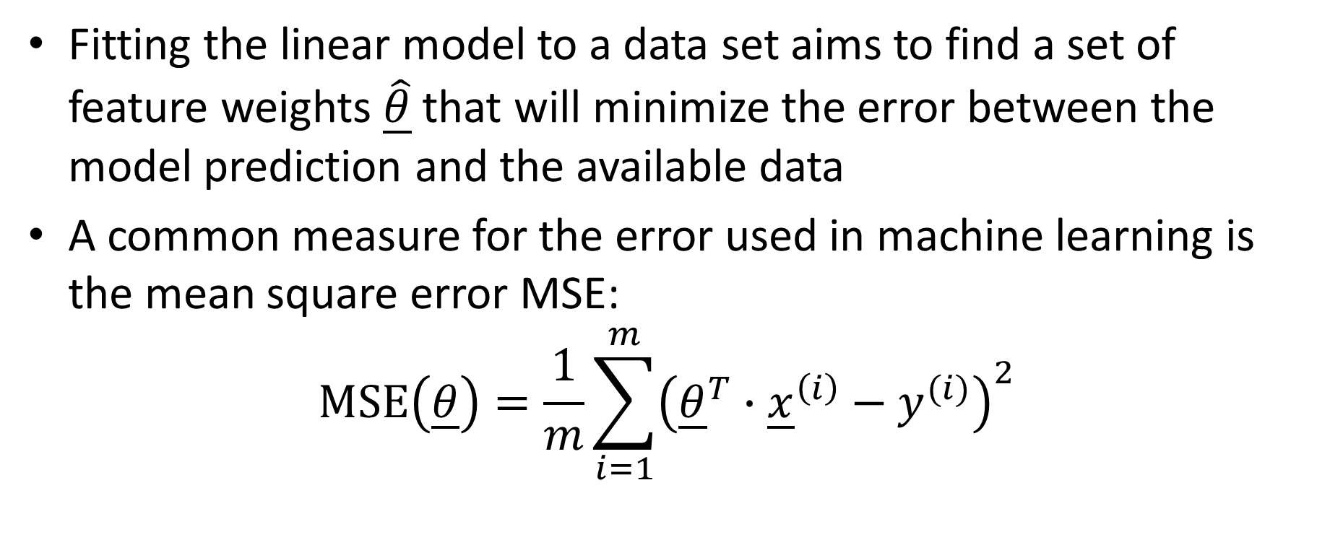
Linear regression
Fitting the linear model to a data set aims to find a set of feature weights $\underline{\hat{θ}}$ that will minimize the error between the model prediction and the available data
A common measure for the error used in machine learning is the mean square error MSE:
$$\text{MSE}\left(\underline{θ}\right)=\frac{1}{m}\sum_{i=1}^{m}{{\left({\underline{θ}}^{T}∙{\underline{x}}^{\left(i\right)}−y^{(i)}\right)}^{2}}$$
Notes:
Let us now turn back to linear regression
Recall that fitting the linear model to a data set aims to find a set of feature weights $\underline{\hat{θ}}$ that will minimize the error between the model prediction and the available data
A common measure for the error used in machine learning is the mean square error MSE
Using our notations in vector form the mean square error can be written in a compact form
The expression ${\underline{θ}}^{T}∙{\underline{x}}^{\left(i\right)}−y^{(i)}$ computes the difference between the model prediction and label of a given instance.
Squaring it and summing over all instances in the data set allows us to compute the square error
Dividing by the number of instances m in the data set gives us the mean square error
As we learned in the lesson of regression, the mean square error is a function of the model parameters, or feature weights as they are called in machined learning
For each new choice of the feature weights the mean square error changes. The goal is to find the feature weights that will minimize the mean square error

Slide 9
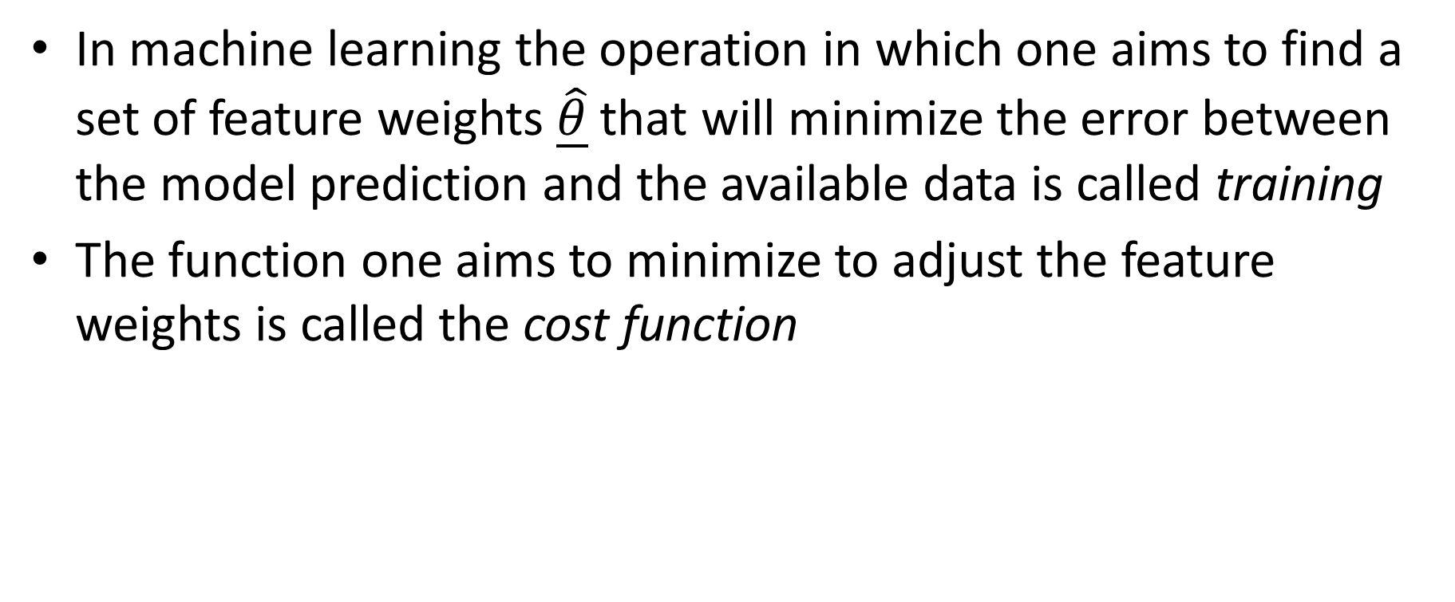
Some terminology
In machine learning the operation in which one aims to find a set of feature weights $\underline{\hat{θ}}$ that will minimize the error between the model prediction and the available data is called training
The function one aims to minimize to adjust the feature weights is called the cost function
Notes:
Let us add some comments on the terminology used in machine learning
In machine learning the operation in which one aims to find a set of feature weights $\underline{\hat{θ}}$ that will minimize the error between the model prediction and the available data is called training
In the context of linear regression we called it curve fitting
The function one aims to minimize to adjust the feature weights is called the cost function
As we will see progressively, there are more general functions than for example the mean square error that are used in machine learning.

Slide 10
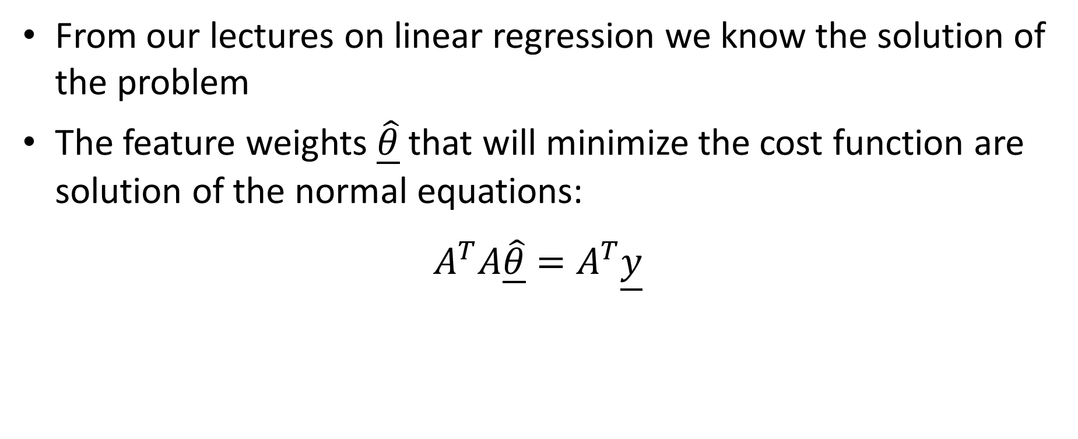
Normal equations
From our lectures on linear regression we know the solution of the problem
The feature weights $\underline{\hat{θ}}$ that will minimize the cost function are solution of the normal equations:
$$A^{T}A\underline{\hat{θ}}=A^{T}\underline{y}$$
Notes:
From our lectures on linear regression we know the solution of the problem of curve fitting or training
The feature weights $\underline{\hat{θ}}$ that will minimize the cost function are solution of the normal equations:
$$A^{T}A\underline{\hat{θ}}=A^{T}\underline{y}$$
where the matrix A is the coefficient matrix of the set of none-consistent equations one obtains when applying the model to all instances of the data set
Let us now discuss a little in more details how we can build this coefficient matrix

Slide 11
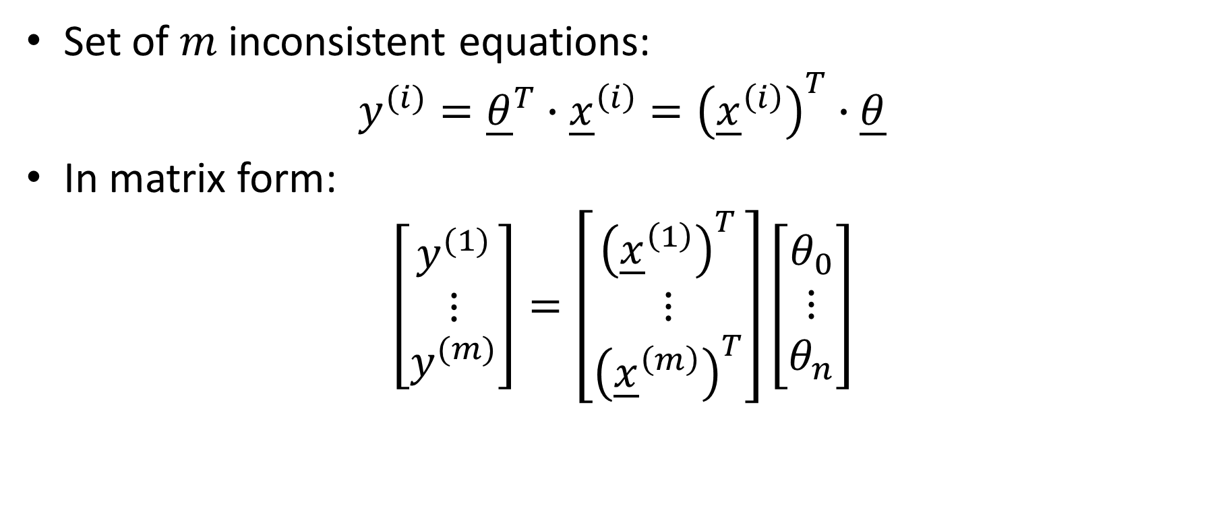



Normal equations
Set of $m$ inconsistent equations:
$$y^{(i)}={\underline{θ}}^{T}∙{\underline{x}}^{\left(i\right)}={\left({\underline{x}}^{\left(i\right)}\right)}^{T}∙\underline{θ}$$
In matrix form:
$$\left[\begin{matrix}y^{(1)} \\ \begin{aligned}⋮\end{aligned} \\ y^{(m)}\end{matrix}\right]=\left[\begin{matrix}{\left({\underline{x}}^{\left(1\right)}\right)}^{T} \\ \begin{aligned}⋮\end{aligned} \\ {\left({\underline{x}}^{\left(m\right)}\right)}^{T}\end{matrix}\right]\left[\begin{matrix}θ_{0} \\ \begin{aligned}⋮\end{aligned} \\ θ_{n}\end{matrix}\right]$$
$m$ equations
$n+1$ unknowns $θ_{i}$
Coefficient matrix $A$ of size ($n+1)×m$
Notes:
To build the coefficient matrix A one first has to write down the set of of none-consistent equations one obtains when applying the model to all instances of the data set
For the instance number i the equation writes
$$y^{(i)}={\underline{θ}}^{T}∙{\underline{x}}^{\left(i\right)}={\left({\underline{x}}^{\left(i\right)}\right)}^{T}∙\underline{θ}$$
If we write down all this equations we can write them in a matrix form as shown on the slide
First of all we have a total of m equations as our data set contains m instances
For example m pictures
As our model as n+1 feature weights we have n+1 unknowns $θ_{i}$
We have n+1 feature weights because each instance has n features (for example the n pixels of our image) and one additional bias term $θ_{0}$
This results in a (n+1) times m coefficient matrix A
Each line of this matrix is an instance written in a line vector
Don’t forget to add a ‘1’ in the first entry of the instance vector

Slide 12
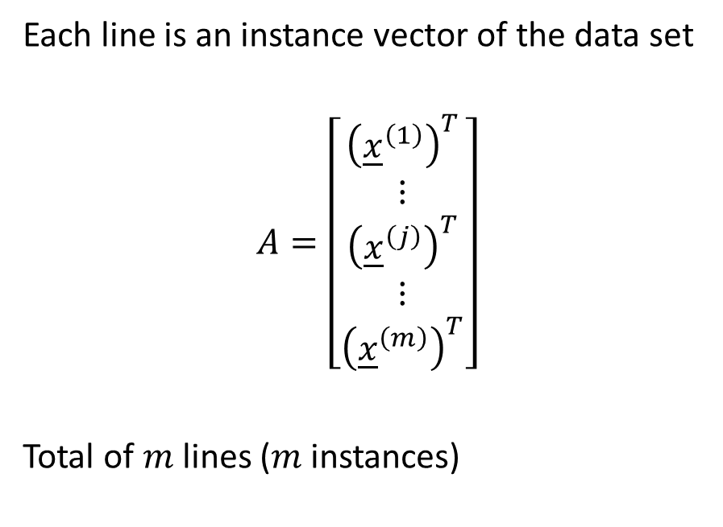
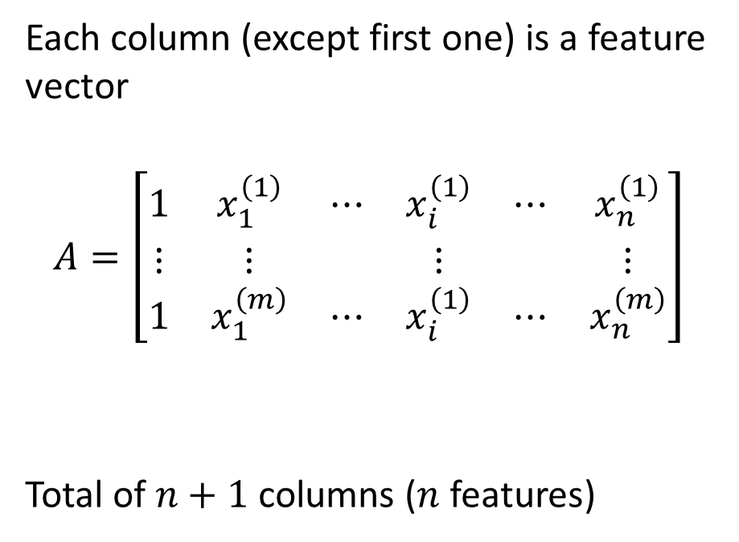
Structure of the coefficient matrix
Lines
Columns
Each line is an instance vector of the data set
$$A=\left[\begin{matrix}{\left({\underline{x}}^{\left(1\right)}\right)}^{T} \\ \begin{aligned}\begin{aligned}⋮\end{aligned} \\ {\left({\underline{x}}^{\left(j\right)}\right)}^{T} \\ ⋮\end{aligned} \\ {\left({\underline{x}}^{\left(m\right)}\right)}^{T}\end{matrix}\right]$$
Total of $m$ lines ($m$ instances)
Each column (except first one) is a feature vector
$$A=\left[\begin{matrix}1 & x_{1}^{\left(1\right)} & ⋯ & x_{i}^{\left(1\right)} & ⋯ & x_{n}^{\left(1\right)} \\ ⋮ & ⋮ & & ⋮ & & ⋮ \\ 1 & x_{1}^{\left(m\right)} & ⋯ & x_{i}^{\left(1\right)} & ⋯ & x_{n}^{\left(m\right)}\end{matrix}\right]$$
Total of $n+1$ columns ($n$ features)
an instance
a feature
Notes:
Practically, the coefficient matrix A can be built in two convenient ways
If we consider the lines of the matrix A, as we mentioned in the previous slide, each line is an instance written as a column vector
Alternatively you can build the matrix A column wise
In this case each column represents all features form the data set
For example column number i, list all features number i of all instances of the data set
Note that the first column will always be a column made out of ones
Depending on how the data set is organized there are cases where building the matrix A line by line is simpler, sometimes building it column by column is simpler.

Slide 13






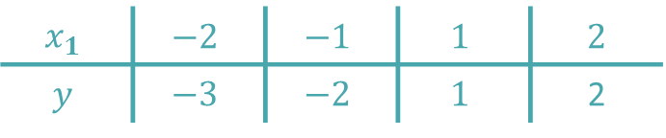

Example
Data set with $n=1$feature and $m=4$ instances
Model: $y=θ_{0}+{θ_{1}x}_{1}$
Vector notation:
$$x_{1}$$ | $$−2$$ | $$−1$$ | $$1$$ | 2
$$y$$ | $$−3$$ | $$−2$$ | $$1$$ | 2
$$\underline{y}=\left[\begin{matrix}−3 \\ \begin{aligned}−2 \\ 1 \\ 2\end{aligned}\end{matrix}\right]$$
$$\underline{θ}=\left[\begin{matrix}θ_{0} \\ θ_{1}\end{matrix}\right]$$
$${\underline{x}}^{(1)}=\left[\begin{matrix}1 \\ −2\end{matrix}\right]$$
$${\underline{x}}^{(2)}=\left[\begin{matrix}1 \\ −1\end{matrix}\right]$$
$${\underline{x}}^{(3)}=\left[\begin{matrix}1 \\ 1\end{matrix}\right]$$
$${\underline{x}}^{(4)}=\left[\begin{matrix}1 \\ 2\end{matrix}\right]$$
Notes:
The various notations and terminology introduced are at the beginning a little tricky to be used.
Let us consider a simple example to illustrate them.
For this we consider a data set with only n=1 feature x1 and m=4 instances
The displayed plot gives a graphical representation of this data set
The linear model writes then as $y=θ_{0}+{θ_{1}x}_{1}$
Let us now write down this information using our various notations
First, we have the feature vector $\underline{θ}$
This vector contains the bias term $θ_{o}$ and the feature weight $θ_{1}$
Then we have our instance vectors for our four instances
For example ${\underline{x}}^{(1)}$ is the column vector [1 -2]
The ‘1’ is because we use the mathematical trick we discussed earlier
All instance vectors will contain this entry
Finally we have the output vector y
It contains the four entries of the outputs of the data set
I recommend that you write down on a paper these vectors as we will use them in the coming slides

Slide 14
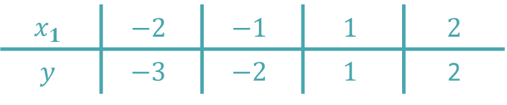
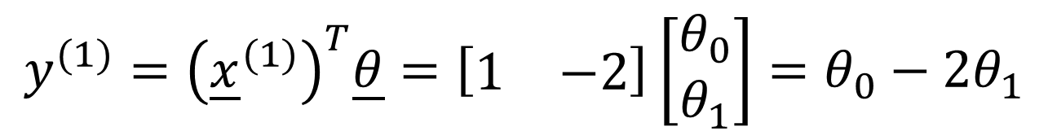

Example
With these notations we can write down the set of inconsistent equations
For example for instance number 1:
$$x_{1}$$ | $$−2$$ | $$−1$$ | $$1$$ | 2
$$y$$ | $$−3$$ | $$−2$$ | $$1$$ | 2
$$−3=θ_{0}−2θ_{1}$$
$$y^{(1)}={\left({\underline{x}}^{(1)}\right)}^{T}\underline{θ}=\left[\begin{matrix}1 & −2\end{matrix}\right]\left[\begin{matrix}θ_{0} \\ θ_{1}\end{matrix}\right]=θ_{0}−2θ_{1}$$
Notes:
With these notations we can write down the set of inconsistent equations
Let us write down such an equation for the instance number 1
The equation is, based on the data set and the model:
$$−3=θ_{0}−2θ_{1}$$
This equation can be written in vector notation as displayed on the slide
I invite you to take a minute to well understand this vector equation and try out by yourself to write down the vector equations for the three other instances of the data set

Slide 15
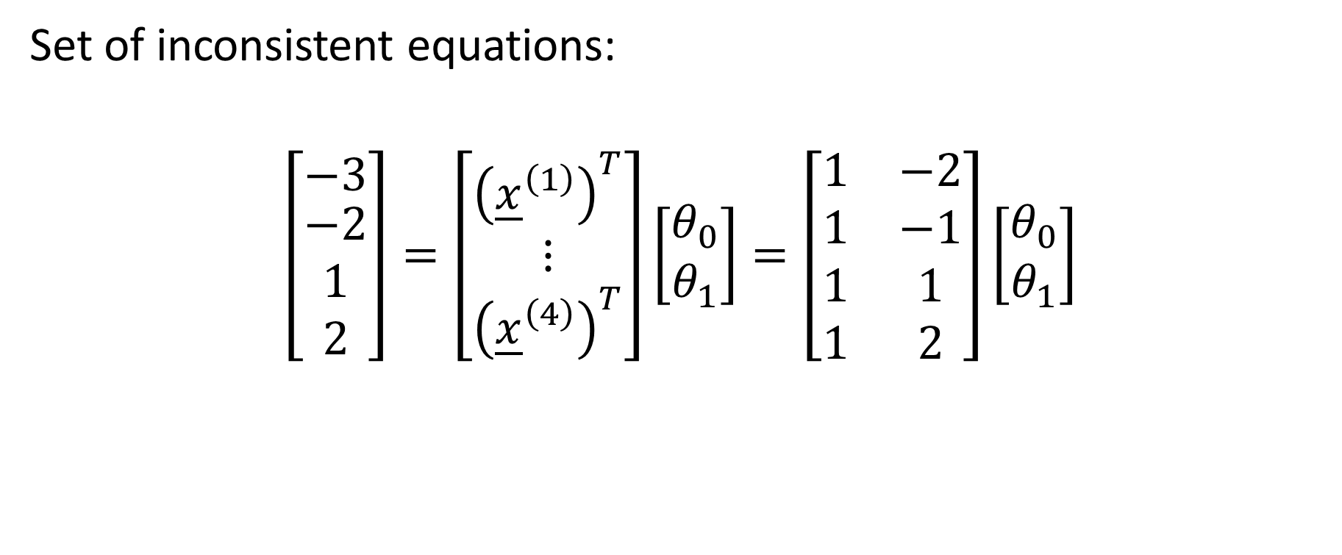


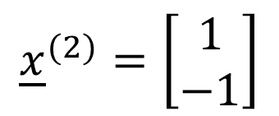
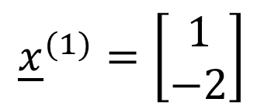
Example
Set of inconsistent equations:
$$\left[\begin{matrix}−3 \\ \begin{aligned}−2 \\ 1 \\ 2\end{aligned}\end{matrix}\right]=\left[\begin{matrix}{\left({\underline{x}}^{\left(1\right)}\right)}^{T} \\ \begin{aligned}⋮\end{aligned} \\ {\left({\underline{x}}^{\left(4\right)}\right)}^{T}\end{matrix}\right]\left[\begin{matrix}θ_{0} \\ θ_{1}\end{matrix}\right]=\left[\begin{matrix}1 & −2 \\ 1 & −1 \\ 1 & 1 \\ 1 & 2\end{matrix}\right]\left[\begin{matrix}θ_{0} \\ θ_{1}\end{matrix}\right]$$
$${\underline{x}}^{(1)}=\left[\begin{matrix}1 \\ −2\end{matrix}\right]$$
$${\underline{x}}^{(2)}=\left[\begin{matrix}1 \\ −1\end{matrix}\right]$$
$${\underline{x}}^{(3)}=\left[\begin{matrix}1 \\ 1\end{matrix}\right]$$
$${\underline{x}}^{(4)}=\left[\begin{matrix}1 \\ 2\end{matrix}\right]$$
Notes:
To write down the set of inconsistent equations in matrix notation we can proceed either line by line to form the coefficient matrix or column by column
Let us start by using the line by line approach
For this we fill the lines of the coefficient matrix with the instance vectors
The first line is made using the first instance vector [1 -2]
The second line using the second instance vector [1 -1]
The third line using the third instance vector [1 1]
And finally the last line using the forth instance vector [1 2]

Slide 16

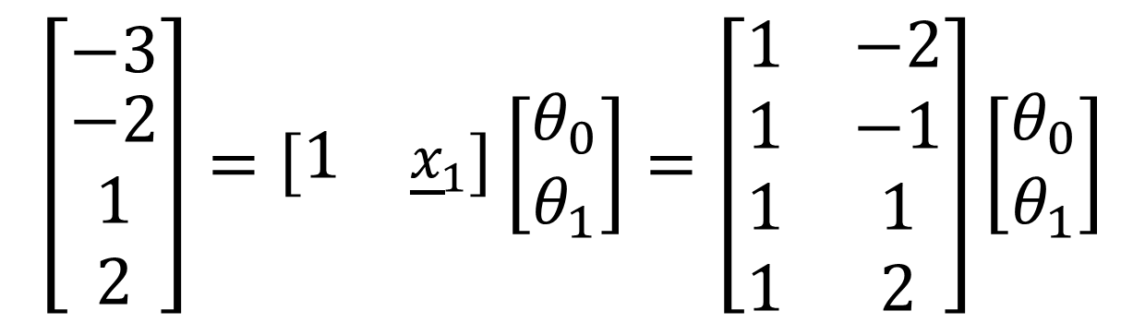

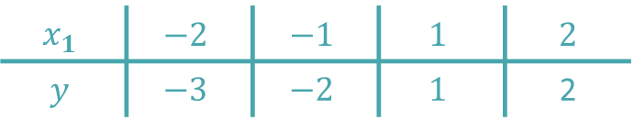
Example
Alternative way to form the inconsistent equations
$${\underline{x}}_{1}=\left[\begin{matrix}−2 \\ \begin{aligned}−1 \\ 1 \\ 2\end{aligned}\end{matrix}\right]$$
$$\underline{y}=\left[\begin{matrix}−3 \\ \begin{aligned}−2 \\ 1 \\ 2\end{aligned}\end{matrix}\right]$$
$$x_{1}$$ | $$−2$$ | $$−1$$ | $$1$$ | 2
$$y$$ | $$−3$$ | $$−2$$ | $$1$$ | 2
$$\left[\begin{matrix}−3 \\ \begin{aligned}−2 \\ 1 \\ 2\end{aligned}\end{matrix}\right]=\left[\begin{matrix}1 & {\underline{x}}_{1}\end{matrix}\right]\left[\begin{matrix}θ_{0} \\ θ_{1}\end{matrix}\right]=\left[\begin{matrix}1 & −2 \\ 1 & −1 \\ 1 & 1 \\ 1 & 2\end{matrix}\right]\left[\begin{matrix}θ_{0} \\ θ_{1}\end{matrix}\right]$$
Notes:
Let us now use the column by column approach
For this we write down the feature vector x1 by listing all features column wise
I encourage you to write down this vector on your paper as we will need it in the coming slide
We further need the output vector y which we had already
The coefficient matrix A is then filled column by column
The first column is made of ones only
The second column is made of the first feature vector
In our case it is in fact the only feature vector
We will discuss soon an example with more than one feature

Slide 17
Example – using Octave
octave> x1=[-2; -1; 1; 2];
octave> A=[x1.^0 x1];
octave> y=[-3; -2; 1; 2];
octave> theta = A’*A\A’*y
theta =
-0.50000
1.30000
octave> yfit=A*theta
yfit =
-3.10000
-1.80000
0.80000
2.10000
octave> [1 1.5]*theta
ans = 1.45000
Notes:
Let us show how in octave one can build this coefficient matrix A and afterwards use it to solve the normal equations to find the optimal model parameters
First we enter the feature vector x1
With this vector we can build the coefficient matrix A
Here we use a small trick to make the first column which is made of ones only
For this we compute x1 to the power zero in order to get one as output
Note the dot in the notation. As we already discussed this in previous lessons, this notation tells octave to apply the power operation to each component of the vector
We enter as well the output vector y
To find the optimal model parameters we solve the normal equations
We used here the backslash notation of octave which invokes the PA=LU algorithm to solve the linear equations
In the context of machine learning, people will call this operation as the training of the model.
They will say that the feature weights were trained by the normal equations.
Once we have the optimal parameters, or as machine learning scientist would say, the trained feature weights, we can use them to compute the predicted labels, the y values, which we store in the vector yfit
The graph displays the data points and line passing by the values predicted by the model using the optimal parameters.
If you want to predict the corresponding label of a given feature, this can be easily be done
Say you want to predict the label corresponding to the feature 1.5
For this you simply multiply the instance vector [1 1.5], written as a line vector, by the feature weights trained with the normal equations.
In our case we get 1.45
Graphically this is very obvious. Indeed the y value 1.45 corresponds to the x value of 1.5

Slide 18


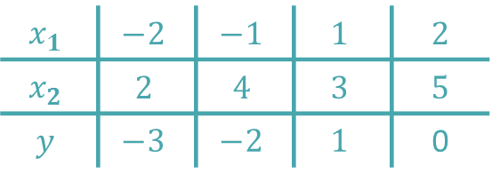
Example
Data set with $n=2$feature and $m=4$ instances
Model:
$$y=θ_{0}+{θ_{1}x}_{1}+{θ_{2}x}_{2}$$
$$x_{1}$$ | $$−2$$ | $$−1$$ | $$1$$ | 2
$$x_{2}$$ | $$2$$ | $$4$$ | $$3$$ | 5
$$y$$ | $$−3$$ | $$−2$$ | $$1$$ | 0
$$\underline{θ}=\left[\begin{matrix}θ_{0} \\ \begin{aligned}θ_{1} \\ θ_{2}\end{aligned}\end{matrix}\right]$$
Notes:
The pervious example had only a single feature. The method we used is in fact exactly the same as we learned in the lesson on linear regression
Let us now do an example with a data set having n=two features.
We use a data set having m=4 instances
The instances are organized as columns in our data table
The model will now involve, beside the bias term, two feature weights and write as
$$y=θ_{0}+{θ_{1}x}_{1}+{θ_{2}x}_{2}$$
The feature vector we want to train is the vector $\underline{θ}=\left[\begin{matrix}θ_{0} \\ \begin{aligned}θ_{1} \\ θ_{2}\end{aligned}\end{matrix}\right]$

Slide 19





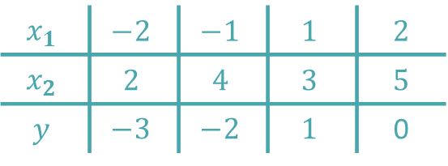
Example
Inconsistent equations
$$x_{1}$$ | $$−2$$ | $$−1$$ | $$1$$ | 2
$$x_{2}$$ | $$2$$ | $$4$$ | $$3$$ | 5
$$y$$ | $$−3$$ | $$−2$$ | $$1$$ | 0
$${\underline{x}}^{(1)}=\left[\begin{matrix}1 \\ \begin{aligned}−2 \\ 2\end{aligned}\end{matrix}\right]$$
$${\underline{x}}^{(2)}=\left[\begin{matrix}1 \\ \begin{aligned}−1 \\ 4\end{aligned}\end{matrix}\right]$$
$${\underline{x}}^{(3)}=\left[\begin{matrix}1 \\ \begin{aligned}1 \\ 3\end{aligned}\end{matrix}\right]$$
$${\underline{x}}^{(4)}=\left[\begin{matrix}1 \\ \begin{aligned}5 \\ 0\end{aligned}\end{matrix}\right]$$
$$\left[\begin{matrix}−3 \\ \begin{aligned}−2 \\ 1 \\ 0\end{aligned}\end{matrix}\right]=\left[\begin{matrix}{\left({\underline{x}}^{\left(1\right)}\right)}^{T} \\ {\left({\underline{x}}^{\left(2\right)}\right)}^{T} \\ {\left({\underline{x}}^{\left(3\right)}\right)}^{T} \\ {\left({\underline{x}}^{\left(4\right)}\right)}^{T}\end{matrix}\right]\left[\begin{matrix}θ_{0} \\ \begin{aligned}θ_{1} \\ θ_{2}\end{aligned}\end{matrix}\right]=\left[\begin{matrix}1 & −2 & 2 \\ 1 & −1 & 4 \\ 1 & 1 & 3 \\ 1 & 2 & 5\end{matrix}\right]\left[\begin{matrix}θ_{0} \\ \begin{aligned}θ_{1} \\ θ_{2}\end{aligned}\end{matrix}\right]$$
Notes:
Let us build the set of inconsistent equations
For this we write down the coefficient matrix A line by line using the instance vectors
The first line of the coefficient matrix is the first instance vector written in a line
Note as always the “1” in the first line of the instance vector ${\underline{x}}^{(1)}$
The two next entries are the x1 and x2 values of the data set corresponding to this first instance
The second line is obtained based on the second instance vector ${\underline{x}}^{(2)}$
And in the same way we write down the thirs and forth line of the coefficient matrix

Slide 20




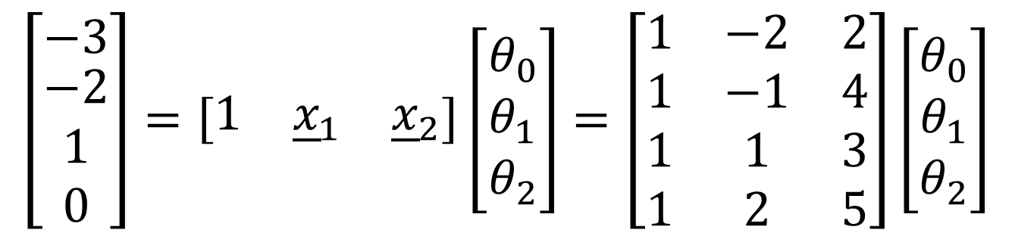
Example
Inconsistent equations
$$\underline{y}=\left[\begin{matrix}−3 \\ \begin{aligned}−2 \\ 1 \\ 0\end{aligned}\end{matrix}\right]$$
$${\underline{x}}_{1}=\left[\begin{matrix}−2 \\ \begin{aligned}−1 \\ 1 \\ 2\end{aligned}\end{matrix}\right]$$
$${\underline{x}}_{2}=\left[\begin{matrix}2 \\ \begin{aligned}4 \\ 3 \\ 5\end{aligned}\end{matrix}\right]$$
$$x_{1}$$ | $$−2$$ | $$−1$$ | $$1$$ | 2
$$x_{2}$$ | $$2$$ | $$4$$ | $$3$$ | 5
$$y$$ | $$−3$$ | $$−2$$ | $$1$$ | 0
$$\left[\begin{matrix}−3 \\ \begin{aligned}−2 \\ 1 \\ 0\end{aligned}\end{matrix}\right]=\left[\begin{matrix}1 & {\underline{x}}_{1} & {\underline{x}}_{2}\end{matrix}\right]\left[\begin{matrix}θ_{0} \\ \begin{aligned}θ_{1} \\ θ_{2}\end{aligned}\end{matrix}\right]=\left[\begin{matrix}1 & −2 & 2 \\ 1 & −1 & 4 \\ 1 & 1 & 3 \\ 1 & 2 & 5\end{matrix}\right]\left[\begin{matrix}θ_{0} \\ \begin{aligned}θ_{1} \\ θ_{2}\end{aligned}\end{matrix}\right]$$
Notes:
Alternatively we could have built the coefficient matrix column by column
For this we define the feature vectors x1 and x2
The set of inconsistent equations is then given by y, the label vector, equal to the the coefficient matrix A times the feature weight vector
The coefficient matrix has three columns
The first one is a column of ones
The second one is the first feature vector x1
And the third one the second feature vector x2
Of course we obtain the same coefficient matrix as in the previous slide
In future you may chose either method to build it depending what you prefer most

Slide 21
Example
octave> x1=[-2; -1; 1; 2];
octave> x2=[2; 4; 3; 5];
octave> A=[x1.^0 x1 x2];
octave> y=[-3; -2; 1; 0];
octave> theta = A’*A\A’*y
theta =
1.10000
1.20000
-0.60000
octave> yfit=A*theta
yfit =
-2.50000
-2.50000
0.50000
0.50000
octave> [1 1.5 3]*theta
ans = 1.1000
Notes:
Let us now use octave to build the coefficient matrix and afterwards solve the normal equations in order to find the optimal feature weights fitting the data set
First we define the two feature vectors x1 and x2 based on our data set
Note we decided to enter them as column vectors
We build A by putting together three columns
The first one is a column of ones which we build with the trick computing the vector x1 to the power zero
The second column is the feature vector x1 and the third one is the feature vector x2
Note how simple it is to define this matrix A
Remains to enter the label vector y
To find the optimal model parameters we solve the normal equations
We use the backslash notation of octave to invokes the PA=LU algorithm to solve the linear equations
Again, in the context of machine learning, people would call this operation the training of the model.
Having trained our model we can now use it to make some prediction
Let us for example the label y corresponding to the features [1.5 3]
For this we multiply the instance vector [1 1.5 3], written as a line vector, by the trained feature weights
In our case we predict the value of 1.1

Slide 22
Summary
The normal equations can be used to fit a multilinear model to a dataset
In the context of machine learning this operation is called training the multilinear model
The coefficient matrix A required in the normal equations can be built either line by line or column by column, depending on how the data set is organized
Notes:
Let us summarize the key findings
The normal equations can be used to fit a multilinear model to a dataset
In the context of machine learning this operation is called training the multilinear model
The coefficient matrix A required in the normal equations can be built either line by line or column by column, depending on how the data set is organized

